Slide 1
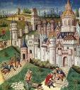
UNIT ONE – DISCOVERY TO 1763
THE EFFECTS OF THE MIDDLE AGES ON WESTERN CULTURE

Slide 2
RELIGION IN THE MIDDLE AGES
Most people in Europe were faithful members of the Roman Catholic Church. (Age of Faith)
The Church was the center of life.
All education was done in the Church. (music, art, literature, architecture)

Slide 3
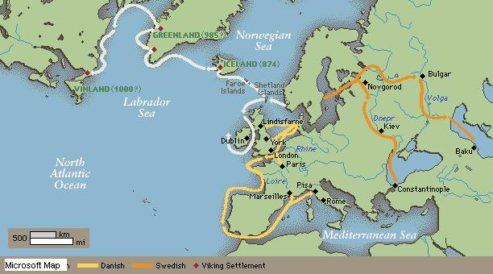
THREATS FROM ABROAD
Central Europe was threatened by the Vikings (Scandinavia).
Vikings raided settlements on the coast of Western Europe and settled on Iceland and Greenland.
Around A.D. 1000 Vikings made settlements in North America (VINLAND)

Slide 4
THREAT FROM THE SOUTH
The Muslims (Moors) had conquered North Africa and what is now Spain by 632.
Muslims also controlled the Holy Land and began to limit Christian pilgrimages.

Slide 5
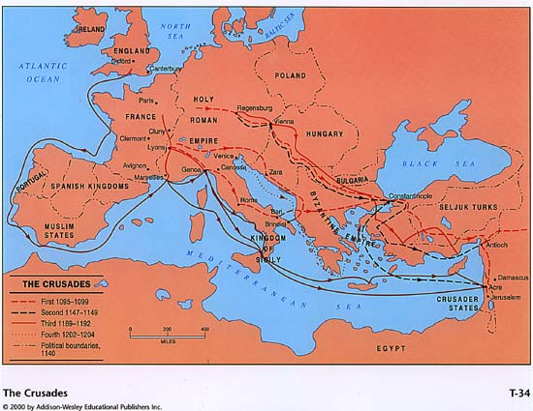
CRUSADES = HOLY WARS
In 1095 Pope Urban II, head of the Roman Catholic Church called on Christians to retake the Holy Land from the Muslims.
Four major crusades spanned about 100 years.
Most of the crusades failed, although it changed contact between the East and Europe.

Slide 6
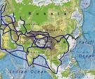
POSITIVES OF THE CRUSADES
The crusades drew thousands of Europeans to the East.
Europeans became familiar with new foods, medicines and goods.
CHINA = silk, dyes, ceramic dishes
SPICES = pepper, nutmeg, cloves, cinnamon, and ginger.
Why were spices important?

Slide 7
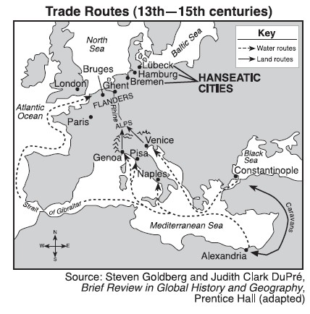
RISE OF NATIONALISM
After crusaders returned home they continued to buy eastern goods from Italian merchants who had traded with the east for a long time.
Italian merchants exchanged European leather, tin, and woolen cloth for Asian spices, silks, and jewels.

Slide 8
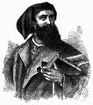
MARCO POLO (1254-1324)
Marco Polo became the most famous of these Italian merchants.
When he was seventeen he journeyed to China with his father and uncle.
Marco Polo lived and traveled in Asia from 1271 – 1295 (24 years)
His adventures were written in a book (The Travels of Marco Polo)although most did not believe what he reported.

Slide 9
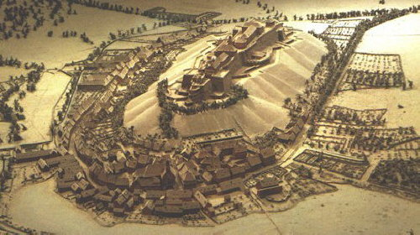
DECLINE OF FEUDALISM
The growth of trade and the decline of towns during the Middle Ages (500-1500A.D.) weakened the feudal system.
To keep laborers on the land they had to be paid.
Manors declined as trade increased.
Nobility began to lose power and towns people became more influential.

Slide 10
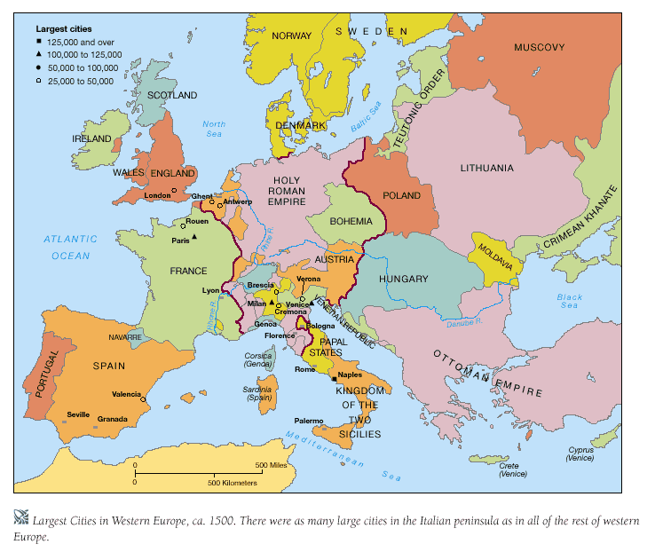
STRONG MONARCHS EMERGE
As feudal lords lost their power strong monarchs built strong governments in what will be England, France, and Portugal.
Power was now concentrated in strong central governments
Large armies were created to enforce order.
People could safely travel and trade flourished.

Slide 11
NATIONALISM
Now Europeans were experiencing NATIONALISM = love for and loyalty to one’s country.
Monarchs sought to strengthen their countries by gaining influence in other parts of the world.

Slide 12
SPIRIT OF CURIOSITY
As the medieval world expanded, curiosity arose.
Scholars began to read the writing of ancient Greece and Rome.
Artists began drawing and painting plants, animals, and people as they really looked.
Art begins to expand with Leonardo da Vinci and Michelangelo Buonarroti.

Slide 13
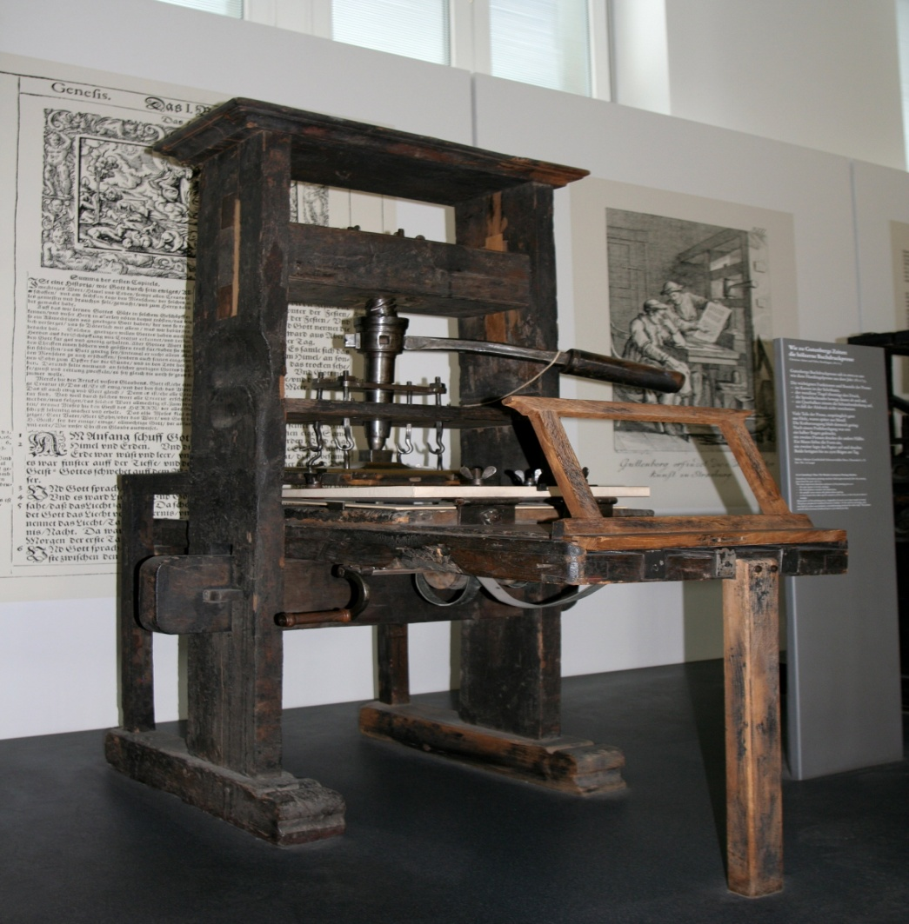
RENAISSANCE
This period of scientific curiosity, return to classical learning, and praise of humanity was called the RENAISSANCE = French term meaning rebirth.
The renaissance begins in Northern Italy in 1300s and marks the beginning of the modern age.
The renaissance spreads with Johannes Gutenberg’s printing press around 1438.
WHY?

Slide 14
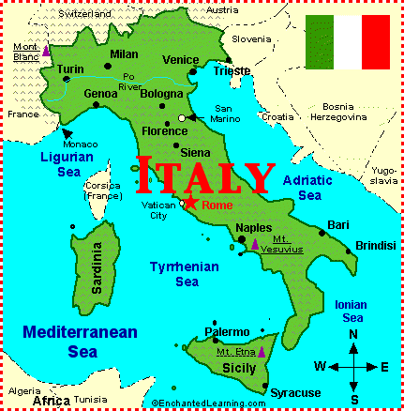
FINANCE
Genoa and Venice Italy were the two most richest and powerful cities in Europe because they are located on the trade routes of the Mediterranean Sea.
They became the gateways through which rare goods reached Europe and Asia.

Slide 15
JOINT-STOCK COMPANY
Italian merchants needed large amounts of money to finance the growing trade.
Bankers devised the JOINT-STOCK COMPANY = Used to accumulate a large amount of capital, a number of people pooled their funds.
Italian merchants developed a MONOPOLY on the Asian trade.
The Italian merchants sold Asian goods for large PROFITS.
Other European countries could not profit from the trade routes.
They needed to find other routes to Asia.

Slide 16
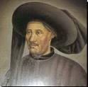
PORTUGAL
In the early 1400s Prince Henry of Portugal(son of King John I) began to explore the unknown ocean.
At the time it was believed that the water boiled at the equator and the ocean was full of sea monsters.

Slide 17
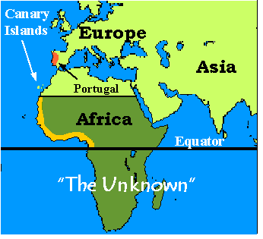
PRINCE HENRYS GOAL’S
Find an all-water route to the trading centers of Asia.(Break Italy’s monopoly)
Develop a powerful navy to defeat the Muslim forces in North Africa.
Spread Christianity beyond Europe’s borders.
Wanted to learn more about the ocean and the lands beyond it.

Slide 18
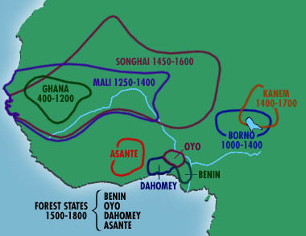
PORTUGAL AND AFRICA
Portuguese ships continued to explore southward along the West African coast.
They encountered kingdoms such as Songhai, Benin, Kongo, and Mali.
The centers of trade were the Mali cities of Gao and Timbuktu
The Portuguese traded for gold and ivory and by 1440s they were trading for slaves.

Slide 19
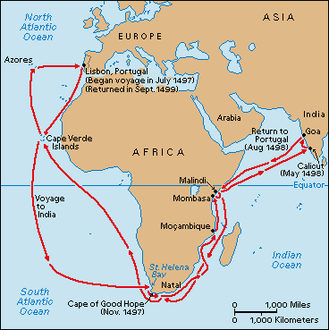
WATER ROUTE TO ASIA
Prince Henry died in 1473 before Portugal crossed the equator.
In 1487, Bartolomeu Dias sailed around the tip of Africa.
In 1498 Vasco da Gama continued the route along the eastern coast of Africa, turned east across the Indian Ocean and reached India.
Lisbon, Portugal became the richest port in Europe.

Slide 20
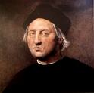
CHRISTOPHER COLUMBUS
He grew up in the Italian city of Genoa.
Began going to sea at age 14.
Went to Lisbon and learned mapmaking, and taught himself to read and write Spanish.
He also learned Latin.
Became fascinated with the Far East or Indies.

Slide 21
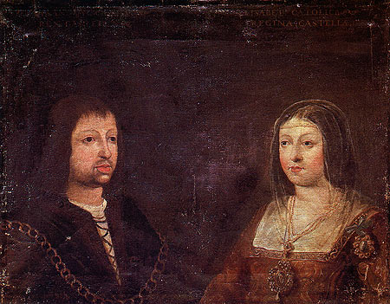
COLUMBUS’S VISION
He wanted to find a sea route to the Indies by sailing west.
Knew the earth was round – forgot about the Vikings.
He approached the Portuguese King for assistance and was denied.(Why?)
He went to Spain and approached King Ferdinand and Queen Isabella.

Slide 22
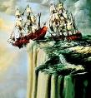
SPAIN IS INTERESTED
The Spanish monarchs saw this as a chance too compete with Portugal.
They also saw this as a way to spread Christianity.
In 1492 after defeating the Moors in Granada the monarchs were to support Columbus.
On Friday, August 3, 1492 three ships: the Nina, Pinta, and Santa Marie left Spain and sailed southwest.

Slide 23
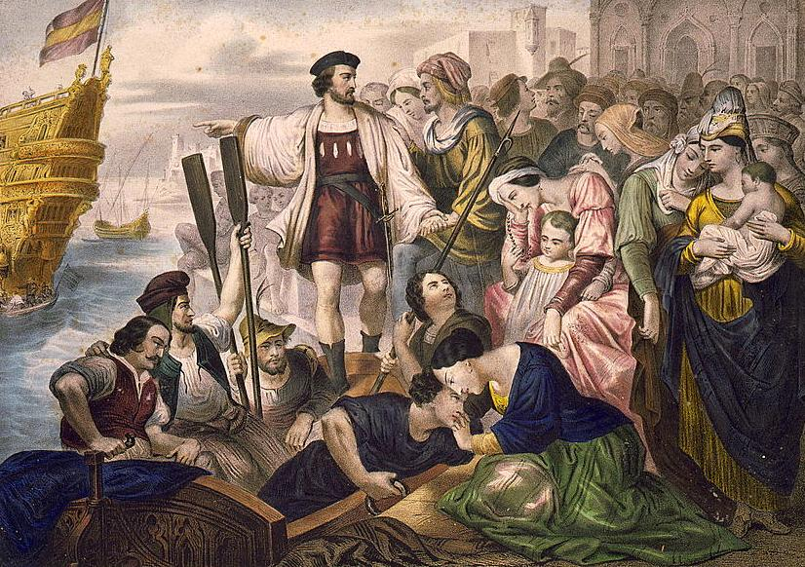
COLUMBUS’S DISCOVERY
Columbus had a crew of 90 sailors most of them teenagers.
On October 10 after ten weeks at sea the crew requested that Columbus turn back.
Columbus convinced them to sail west for three more days and October 12 they sighted land.

Slide 24
THIS IS NOT THE INDIES
No one knows for sure where Columbus landed, probably in the Bahamas, on an island he named San Salvador.
He did not find the gold and jewels he was expecting – he saw grass houses and people with few clothes.
He continued to zigzag through the Caribbean Sea looking for the treasures.
He found enough gold on the island of Hispaniola to convince himself that he had landed in A

Slide 25
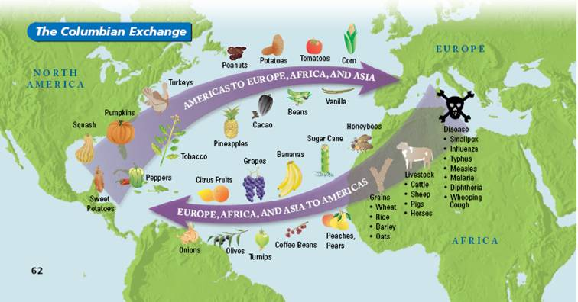
THE COLUMBIAN EXCHANGE
The transfer of plants, animals, and disease form one hemisphere to the other is known as = THE COLUMBIAN EXCHANGE.
Spanish settlers took their language, religion, plants, animals, and disease to the new lands.
European settlers took wheat, fruit trees, horses, cattle, sheep, goats, and pigs.
By doing this Europeans enlarged the food supply of the “NEW WORLD”

Slide 26
COLUMBIAN EXCHANGE CONTINUED
On their return voyages Europeans also took back foods and plants that were unique to the Western Hemisphere.
These products changed diets around the world and helped to feed a growing population.
The poor of Europe were the first to accept these strange foods.
Corn helped to end the recurring famines in Northern Italy.
Potatoes also helped to end famines, especially in Ireland.
Other foods brought back were peanuts, sweet potatoes, chili peppers, tomatoes, and chocolate.
Tobacco and rubber were also brought from the Americas.

Slide 27
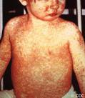
DISEASE
Natives of the “NEW WORLD” had no contact with European diseases.
They had no immunity and contact with the diseases meant death.
Smallpox, Chicken Pox, measles, and influenza.
90 percent of all natives who caught an European disease died.
Native American population dropped from 11 million in 1500 to half a million by 1900.

Slide 28
COLUMBUS AS COLONIZER
Columbus believed that the Europeans were superior to the natives.
As the first European ruler of Hispaniola the policies he set the policies that killed or enslaved untold numbers of natives.
On his first voyage he kidnapped several natives to take back to Spain for servants.
On his second voyage he was told by Ferdinand and Isabella to treat the natives with respect without causing them any problems.
He was to punish anyone who did mistreat the natives.
Instead he rounded up enough natives to fill twelve ships and sent them back to Spain to be sold as slaves.

Slide 29
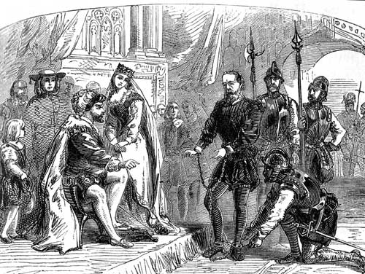
COLUMBUS’S DOWNFALL
The natives of Hispaniola finally revolted against the Spanish – The Spanish then attacked with crossbows, guns, and ferocious dogs.
Columbus went to far when he gave colonist returning to Spain gifts of native slaves.
Isabella was furious. WHY?
The natives were sent back. Columbus was returned in chains, and never allowed to return to Hispaniola.

Slide 30
ENCOMIENDA SYSTEM
After the death of Isabella in 1504, Spanish colonist continued to enslave the natives.
The Spanish crown began the ENCOMIENDA SYSTEM = The monarchs granted land to loyal colonist and also gave them native laborers for a specific number of days each year.
In exchange for the ENCOMIENDAS the colonist promised to convert them to Christianity and protect them
In reality, the colonist often mistreated the natives(Taino)
The encomienda system bound the natives to for life to the colonist who now owned the land that once belonged to them.

Slide 31
COLUMBUS’S PLACE IN HISTORY
He never reached Asia.
He never brought back the riches.
Ferdinand and Isabella stopped supporting him after his fourth voyage.
Columbus continued to believe that he found Asia – geographers realized he didn’t.
Great knowledge was gained from his voyages.
He opened the way for European settlement of the Americas.
New foods and products were now introduced to Europe and the Americas.
New religions and cultures.
Changes the course of world history

Slide 32
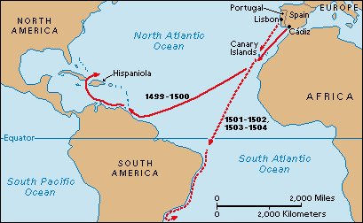
AMERIGO VESPUCCI
An Italian merchant, was outfitter for some of Columbus’s ships.
Had his own expediti0ns to South America (1499-1504).
He realized he had reached a new continent.
German mapmakers named the new continent “AMERICA”.

Slide 33
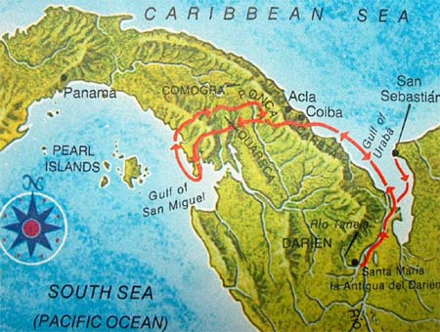
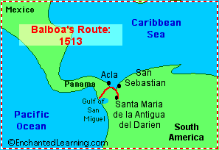
VASCO NUNEZ DE BALBOA
A Spanish adventurer and a colonist of Hispaniola.
He crossed the Isthmus of Panama to find a new sea, he called the South Sea (Pacific).
He claimed the ocean for Spain.
He was executed for treason by Francisco Pizarro.

Slide 34
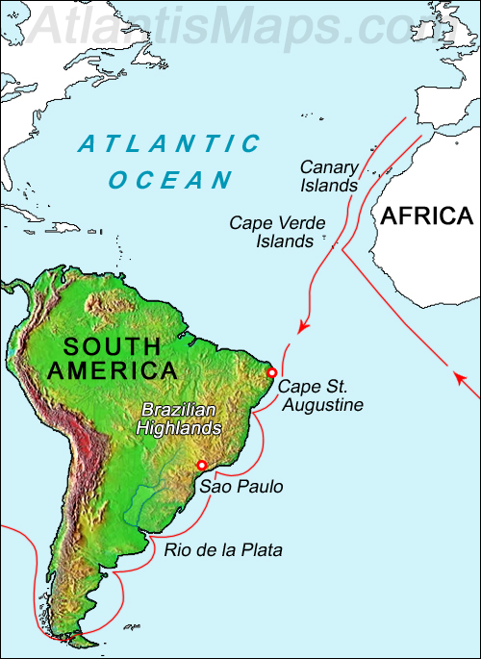
FERDINAND MAGELLAN
He was a captain from Portugal who sailed to the Indies on Vasco da Gama’s routes.
Balboa’s report of another ocean excited Magellan. (maybe Columbus was right)
Spain sponsored him.
He found a STRAIT at the southern end of South America = STRAIT OF MAGELLAN.
He found a peaceful ocean he called the PACIFIC.

Slide 35
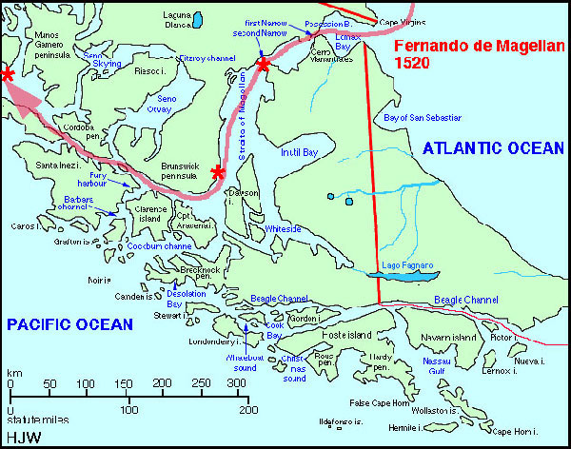
STRAIT OF MAGELLAN

Slide 36
CIRCUMNAVIGATION
For the next four and half months, Magellan and his crew sailed across the Pacific.
With water and food out they reached what are today the Philippines.
Magellan was killed in a tribal war on the Philippines.
The crew continued the journey, led by Juan Sebastian del Cano.
With only one ship left (VICTORIA), the crew landed in Europe, three years after it started.
They were the first to circumnavigate the globe.
First real proof the world was round
The Americas were not part of Asia.

Slide 37
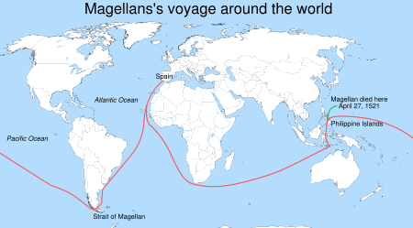
MAGELLAN’S ROUTE

Slide 38
HERNAN CORTES
He was colonist in Hispaniola and became rich.
He wanted to become a CONQUISTADOR.
In 1510 he led an expedition to the Yucatan Peninsula.(11 ships and 450 soldiers)
He was challenged by the Maya Army of 12,000
His small cavalry with armor, holding metal-tipped lances galloped on armored horses towards the Indians.
The Mayans had never seen horses, thought the men on horseback were monsters and fled in terror.
The defeated Mayans offered gifts of gold, cloth and slaves.

Slide 39
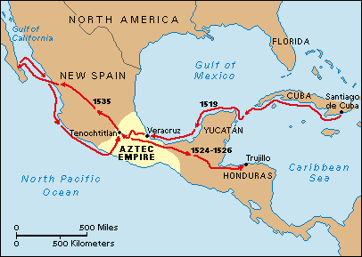
CORTES CONTINUED
He than sailed west then north along the coast.
Created the permanent settlement of VERACRUZ.
Messengers sent word to MONTEZUMA and the AZTECS.
Belief of Quetzalcoatl = god of civilization.

Slide 40
FRANCISCO PIZARRO
He received permission from Spain to explore and conquer Peru.
They made contact with the Inca ruler ATAHUALPA at the town of CAJAMARCA.
While visiting Pizarro, Atahualpa and his people were attacked and he was taken prisoner.
His ransom was gold and silver.
After it was collected Pizarro had Atahualpa strangled.
Pizarro set up the capital at Lima.
Pizarro was the harshest of the conquistadors.
In 1541 he was killed by his own countrymen in a power struggle.

Slide 41
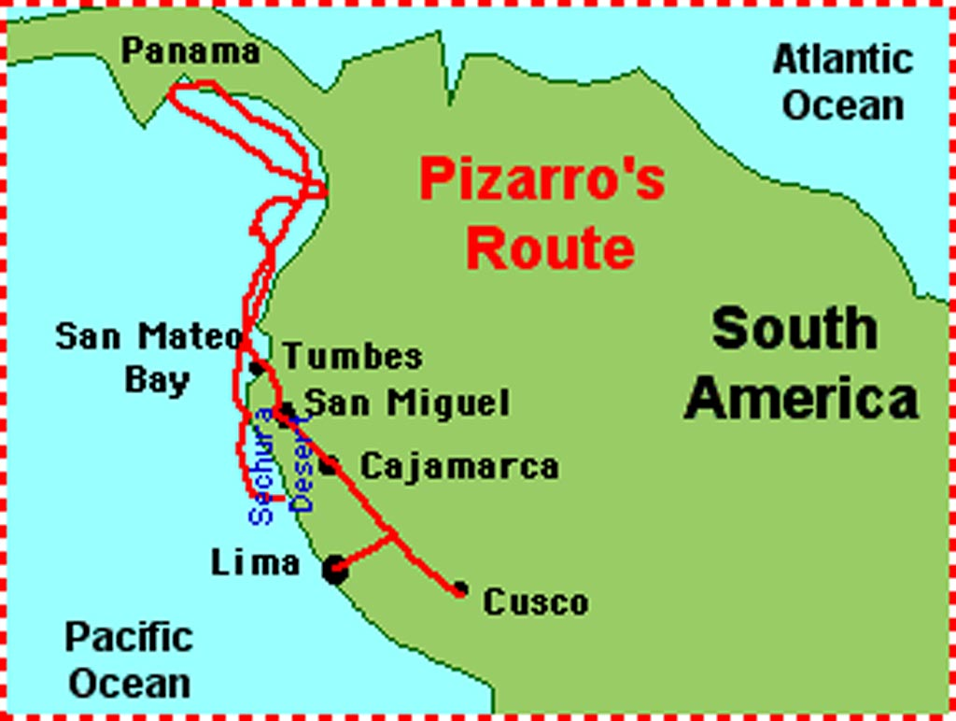
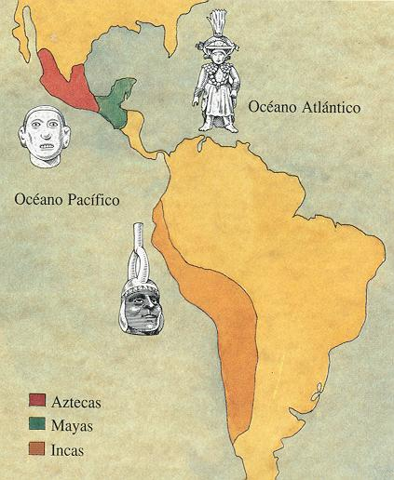
PIZARRO’S ROUTE

Slide 42
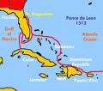
JUAN PONCE DE LEON
He conquered and was the governor of Puerto Rico.
He searched for the Fountain of Youth in 1531 and discovered the land he named Florida = “flower-covered”.
In 1521 he returned to Florida in search gold.
He died from an arrow wound during a native attack.

Slide 43
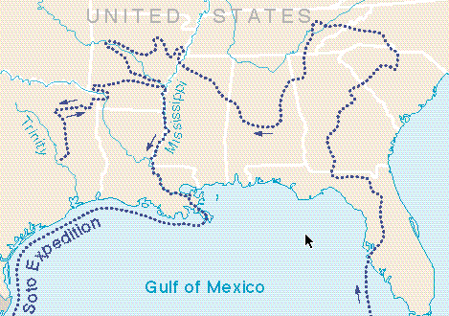
HERNANDO DE SOTO
He landed in what is now Tampa Bay in 1539.
He was looking for gold and went as far north as Tennessee and as far west as Arkansas.
He was the first European to see the Mississippi River.
He died in 1542 of a fever while searching for treasures . ( not real)

Slide 44
JOHN CABOT(Giovanni Caboto)-THE ENGLISH CHALLENGE
John Cabot was born in Geno, Italy and dreamed of sailing west to Asia.
He went to England looking for support.
In 1497 Cabot left England in a Northwest direction and in two months reached the northeastern coast of North America.
His journals and maps were lost, although it was believed he landed in Newfoundland.
He found forests and the rich fishing area of the GRAND BANKS.
He claimed the region for England(Asia)
1498 = Crossed the Atlantic to find Japan, he was not heard of again.

Slide 45
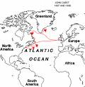
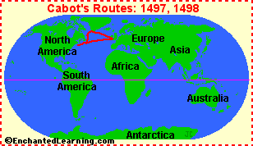
CABOT’S ROUTE

Slide 46
GIOVANNI DA VERRAZANO
By the early 1500s Europeans were still looking for a quick and easy route to Asia(going west)
They were looking for a water route around the Americas (NORTHWEST PASSAGE).
Giovanni da Verrazano was an Italian who sailed for France.
In 1524 he sailed west from France.
He followed the coast of North America from North Carolina to Newfoundland, Canada.
He did not find a passage and returned to France disappointed.

Slide 47
GIOVANNI DA VERRAZANO
By the early 1500s Europeans were still looking for a quick and easy route to Asia(going west)
They were looking for a water route around the Americas (NORTHWEST PASSAGE).
Giovanni da Verrazano was an Italian who sailed for France.
In 1524 he sailed west from France.
He followed the coast of North America from North Carolina to Newfoundland, Canada.
He did not find a passage and returned to France disappointed.

Slide 48
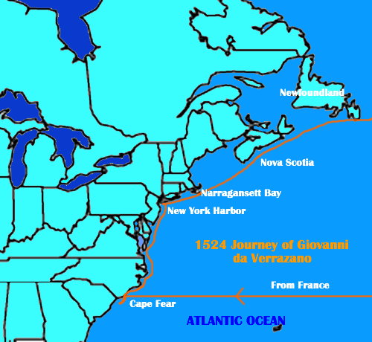
GIOVANNI DA VERRAZANO’S ROUTE

Slide 49
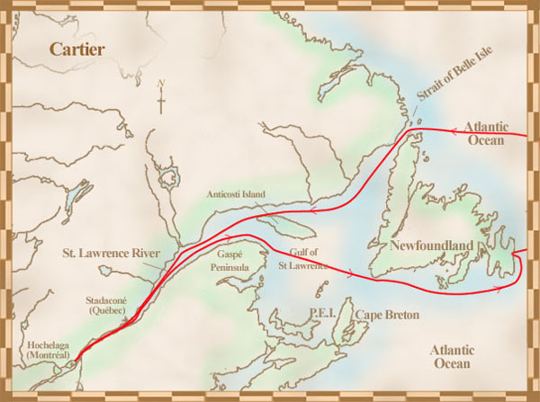
JACQUES CARTIER
Jacques Cartier an explorer for France sailed to America.
In 1535 he reached the St. Lawrence River in Canada.
He hoped this waterway would cut through the continent,
After hundreds of miles he hit rapids where today is Montreal, needed to turn back.
This was the basis for French claims to lands around the St. Lawrence.

Slide 50
SAMUEL DE CHAMPLAIN
In 1603 Samuel de Champlain, a French sea captain explored the Atlantic coast from the mouth of the St. Lawrence to the southern part of Massachusetts.
In 1608 he set up a fur-trading post on the St. Lawrence named Quebec.
QUEBEC = the first permanent French settlement in North America.
He traveled further inland, locating LAKE CHAMPLAIN in New York.
He explored the upper Great Lakes.
He taught others about the Indians and geography of North America.
His discoveries laid the foundation for French colonization of North America.

Slide 51
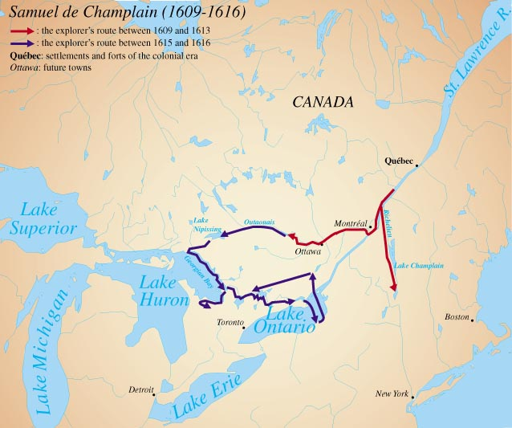
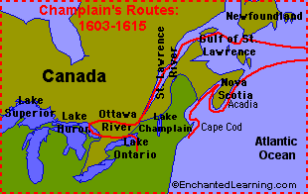
CHAMPLAIN’S ROUTE

Slide 52
HENRY HUDSON
In 1609 Dutch merchants hired an English explorer HENRY HUDSON to find a route to China.
He sailed west across the Atlantic, hit North America, and followed a river(HUDSON RIVER) inland to present-day New York.
This opened the way for Dutch settlers in the region.
In 1610 Hudson returned still looking for the Northwest Passage.
Now he was sailing for England.
He started on the coast of Canada, followed a ice-blocked strait, and discovered a large body of clear water (HUDSON BAY)
He pent all summer in the Bay looking for a passage. In winter they were forced to camp on the frozen shores.

Slide 53
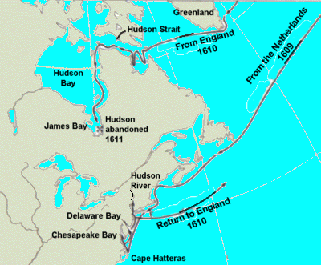
HUDSON CONTINUED
Food was running out and the crew forced Hudson, his son, and few loyal sailors into a small boat.
Hudson was never heard from again.
Only a few members of the crew made it back to England.
Europe was now more interested in America than Asia.

Slide 54
THE REFORMATION
In 1517, a German priest , named Martin Luther, nailed to a church door his protests against the Catholic Church.
This began the REFORMATION = the revolt against the Catholic Church.
Those who revolted were known as PROTESTANTS.
PROTESTANTISM spread, especially to northern Europe.
Europe was now divided between Catholic (authority of the Pope)and Protestant.
The Spanish monarchs now saw themselves as the defenders of the Catholic Church against Protestant.

Slide 55
COLONY IN FLORIDA
In France the King was Catholic, although some people became Protestant.
The Protestants in France were known as the HUGUENOTS.
A Huguenots colony was developed in the Americas. (1) Huguenots saw it as a refuge, (2) Catholics wanted them out of France, (3) It would a French colony in the Americas challenging the Spanish.
In 1564 Fort Caroline was established near present-day Jacksonville, Florida.
None of the people who went knew how to hunt, fish, or farm.
They ran out of food and were waiting for supplies.
In 1565 the supplies arrived by ship, although they were intercepted by the Spanish. (WHAT IS THE ISSUE?)
The Spanish fleet chased away the French fleet, went back to the coast and established a fort, ST.AUGUSTINE = the oldest permanent European settlement in the United States.

Slide 56
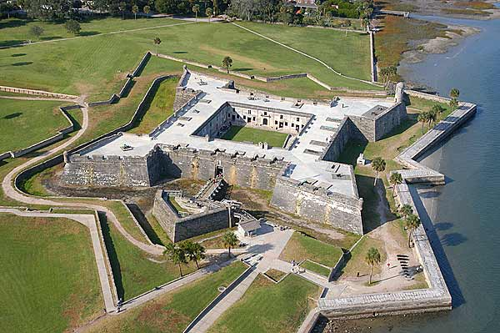
FRENCH AND SPANISH CONTINUED
The Spanish marched from their fort overland and attacked the French at Fort Caroline.
The Spanish killed 142 men, destroyed the fort, although they spared the women and children.

Slide 57
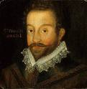
FRANCIS DRAKE
English pirate ships that were now smaller and faster than the Spanish large ships were attacking the Spanish.
The captains of these ships were called SEA DOGS.
The most famous of these sea dogs was Francis Drake.
In 1567 his ship had been attacked by Spanish sailors pretending to by friendly.
Drake sought revenge by raiding Spanish vessels and towns.

Slide 58
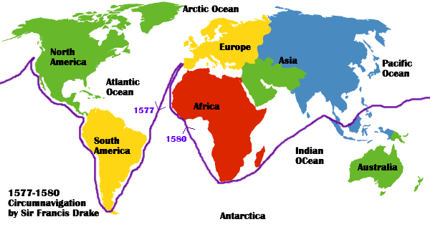
DRAKE CONTINUED
In 1578 Drake sailed through the Strait of Magellan and up the coast of Peru.
The Spanish had never been attacked in their “Spanish Lake” (Pacific)
Drake stole so much Spanish treasure that his ship was overloaded and rode low and slow.
To evade Spanish war ships he sailed north to California and then west across the Pacific.
Drake became the first Englishman to circumnavigate the world.

Slide 59
THE SPANISH ARMADA
King Philip of Spain became very upset when Drake was knighted(Queen Elizabeth).
He assembled an ARMADA = a giant fleet, to invade England and restore Catholicism.
The Armada had 130 ships, 8,000 sailors, and 19,000 soldiers.
In the summer of 1588 it set sail for England.
The English had fewer ships, although they were smaller , faster, and able to carry small powerful canons.
The armada headed for a French harbor to pick up more troops-they were not ready.
The English bottled them up in the harbor-many Spanish ships were destroyed.
The armada headed for home when they were caught in a large storm.
Half of Spain’s ship were lost.

Slide 60
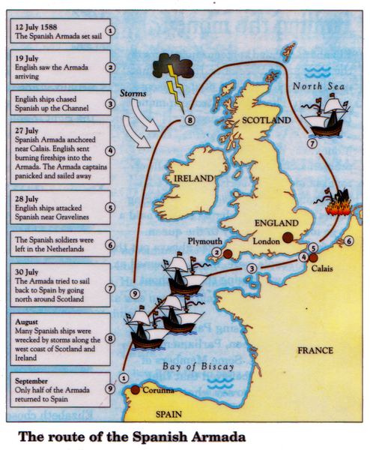
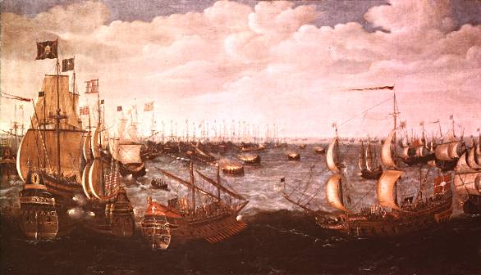
SPANISH ARMADA

Slide 61
SETTLEMENTS AND THE 13 COLONIES - CHARTS

Slide 62
NAVIGATION ACTS
In 1651 the English Parliament passed a series of laws to protect the trade with the colonies = NAVIGATION ACTS.
The colonies could only sell certain items to England or other colonies.
The ships had to be built in England or the colonies.
The laws did boost the colonial shipbuilding industry.
Colonial merchants developed a series of trade routes = TRIANGULAR TRADE.
Rum and iron from New England went to Africa.
Slaves and gold from Africa were sent to the West Indies.
Sugar and molasses from the West Indies was sent to New England to make rum.

Slide 63
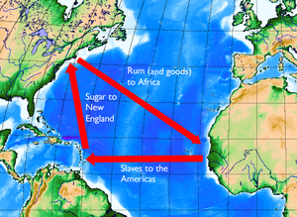
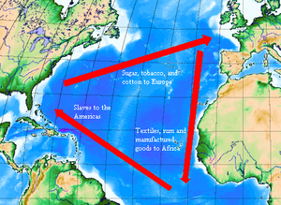
TRIANGULAR TRADE

Slide 64
SALEM WITHCRAFT TRIALS
Puritan New England was originally church centered.
Growing prosperity and the end of Puritan political control led to new ideas and values.
New generations did not always share their parents views.
Younger people started to focus on wealth and the things it could buy.
Puritan ministers started to complain that Salem was full of greedy merchants – morals declining.
Cotton Mather, New England’s leading minister helped to cause a panic in Massachusetts in 1692.
Several hundred people were accused of witchcraft.
In Salem accusations by a group of girls led to the witchcraft trials.
Nineteen people were hanged and one was pressed to death by heavy stones.
The public soon began doubting the girls – the judge and jurors admitted they made errors

Slide 65
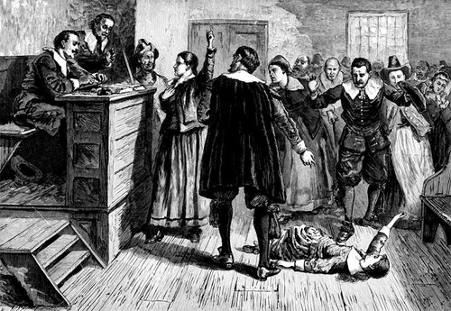
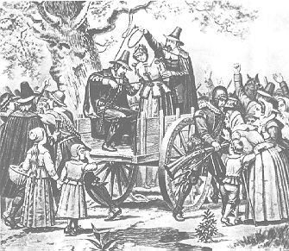

Slide 66
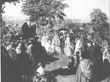
THE GREAT AWAKENING
Between 1720-1750 a new wave of religious enthusiasm swept through New England and other colonies.
Jonathan Edwards was the leader of the Great Awakening in New England.
George Whitefield, and English preacher did the same in other colonies.
They used ‘fire and brimstone” sermons to make people admit their sins and have a spiritual rebirth.
Those who took the preacher’s message = NEW LIGHTS.
Those who were suspicious were = OLD LIGHTS.
This resulted in new religious groups = BAPTISTS AND METHODISTS..

Slide 67
BACON’S REBELLION
In 1676 in Virginia, frontier farmers had many complaints:
1. Low tobacco prices had ruined farmers.
2. Taxes were very high.
3. Political power was in the hands of Sir William Berkeley and a handful of his friends.
3. There had not been an election for 14 years.
4. Indian raids were killing settlers – Berkeley refused to fight the Indians.
Nathaniel Bacon = wealth landowner sided with the farmers, he led an attack against the first Indians they saw.
The Indians were peaceful, fur-trading friends of the governor, although Bacon became a hero.
The Governor allowed elections to better represent the farmers, although the frontier remained unprotected.

Slide 68
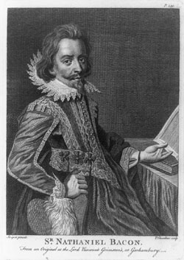
THE REBELLION CONTIUED
Bacon and his followers marched on Jamestown.
BACON’S REBELLION = They forced the governor out.
They Burned most of the town.
Soon Bacon became ill and died.
English soldier crushed the rebellion-Berkeley returned.
Berkeley ordered 23 of Bacon’s followers hanged.
King Charles removed Berkeley, appointed a new Governor.
This was an early sign that the colonist were willing to fight for rights.

Slide 69
FRENCH EXPLORATION
In the 1660 the French Empire in North America included the land around the Great Lakes and St. Lawrence River.
In the winter of 1668 La Salle the Seneca Iroguois told him about a great river (OHIO) that flowed into the sea.
La Salle believed that this could be the Northwest Passage.
The next spring he followed the river almost to the Mississippi, stopped and returned. WHY?

Slide 70
MARQUETTE AND JOLIET
Jacques Marquette (priest) and Louis Joliet(fur trader) were sent out in 1673 to chart the course of the “Great Water”.
Taking two canoes and five men they paddled from Lake Michigan to the Fox River.
They portaged to the Wisconsin River.
Went to the Mississippi and followed it to the Arkansas River.
Fearing they might run into the Spanish, they returned to Lake Michigan.

Slide 71
LA SALLE RETURNS
La Salle was certain he could reach the mouth of the Mississippi and begin settlements.
In 1677 the French King Louis XIV gave him permission.
In 1679 La Salle crossed the Great Lakes by boat.
In 1681 he set off from Lake Michigan to the Illinois River.
They Traveled south on the Mississippi River.
In April 1682 they reached the Gulf of Mexico.
He claimed the land for the French and called it Louisiana.
The drainage of the Mississippi, from the Great Lakes to the Gulf of Mexico.
From the Appalachians to the Rockies.
La Salle planned to build a string of forts from the Great Lakes to the Gulf on the Mississippi.
Each fort would have a French settlement.

Slide 72
LA SALLE’S ROUTE

Slide 73
INDIAN ALLIANCE
The war between the French and English for control of North America was increasing.
It was made worse when each side recruited Native American allies.
FRENCH = ALGONQUIN AND HURON
ENGLISH = IROQUOIS
The Iroquois consisted of six tribes and around 1500 they united to form LEAGUE OF THE IROQUIS.
This was done to end the almost constant fighting among the tribes.
They would become the most powerful Indian confederation in America.
Each tribe had seats in the council and each tribe had one vote.
The Iroquois had taken over more land and were threatening the French Fur Trade.
This resulted in a series of wars between the French, the English and their allies.

Slide 74
ALLIANCE CONTINUED
1. King William’s War = 1689-1697
2. Queen Anne’s War = 1702-1713
King George’s War = 1744-1748
None of these changed the balance of power in North America.

Slide 75
ALBANY PLAN OF UNION
France and Britain were both building forts on the territory of the SIX NATIONS OF THE IROQUIS.
No one really knew the boundaries of the territory.
In 1754 a meeting was held in Albany to discuss the relations with the Iroquois.
Ben Franklin representing Pennsylvania believed the British colonies had to join together for a mutual defense.
He made this point with the first political cartoon in America.

Slide 76
ALBANY CONTINUED
Ben Franklin went to Albany to discuss issues with the Iroquois and to present a plan of union for the colonies = ALBANY PLAN OF UNION.
1. Each colony would have representatives at a new council.
2.The head of the council would be appointed by the crown.
3. The council would have the authority to make war or peace with the Indians.
4. It could raise armies, construct forts, levy taxes, and create new settlements.
His plan showed respect for the Iroquois.
He believed that it would be strange for the Iroquois to develop a league but the colonist could not.
The colonist rejected the plan .
1.Did not want to give up power to a central government.
2. Did not want to pay taxes for joint defense.

Slide 77
FORKS OF THE OHIO
In April of 1754 George Washington from Virginia led 132 soldiers into the upper Ohio Valley.
His orders were to drive the French from this area.
At the forks of the Ohio River the Allegheny and the Monongahela Rivers meet to help form the Ohio River.
Whoever controlled this site could control access to the Ohio Valley.
An advanced party had been sent to build a fort at the forks.
As Washington approached his scouts reported that 350 canoes with about 1,000 French soldiers were arriving.
The Virginians surrendered the fort – the French took it over (FORT DUQUESNE)
While Washington waited for reinforcements he built a simple fort called FORT NECESSITY.

Slide 78
THE FORKS CONTINUED
In July of 1754 French soldiers advanced on Fort Necessity.
They did not attack the fort, rather they surrounded the fort and shot down on it.
It rained all day and soaked the forts gunpowder.
Washington was forced to retreat to Virginia.
The battle at Fort Necessity was the first battle of the FRENCH AND INDIAN WAR. This war would be part of a larger war known as the SEVEN YEARS’ WAR (1756-1763)
The French and British would fight each other in Europe, India, and North America.

Slide 79
FRENCH AND BRITISH
The French had four advantages.
1. France controlled more land in North America than the British.
2. New France had a single government that could act quickly – Britain had 13.
3. France sent professional soldiers rather than colonist
4. The French could count on help from the Huron and Algonquin.
The British strong points.
1. Many more settlers lived in the British colonies than in New France.
2. The British colonies were easier to defend. (Atlantic Coast)
3. Most of the English colonist were willing to fight hard to save their home, land, and families.
*At the beginning the Iroquois sided with the French or remained neutral.

Slide 80
GENERAL EDWARD BRADDOCK
In 1755 General Braddock made another attempt to drive the French from the Ohio Valley.
He was in charge of an army of Virginian and British soldiers.
Braddock’s Army got within a few miles of the fort and than stationed canons in firing range.
The French sent out 250 soldiers dressed as Indians along with 600 real Indians.
They lay in ambush as the British in their Bright Red Uniforms were marching.
The French and Indians attacked, after three hours of fierce fighting Braddock(five horses), two-thirds of the British soldiers, and eight women were dead.
The French kept control of the Ohio Valley for the next two years.
In 1757 things began to change.

Slide 81
BRITISH BEGIN TO WIN
In 1757 a new British Government was formed – William Pitt was now the Secretary of State and the prime minister.
He poured vast amounts of money into the war – throwing England into debt.
He persuaded the colonies to furnish more troops and money.
1758 – The British capture Fort Louisbourg at the mouth of the St. Lawrence.
The British captured Fort Duquesne, renamed it Fort Pitt – Today it is Pittsburgh, Pennsylvania.

Slide 82
THE CRUCIAL YEAR - 1759
In the summer of 1759, the British under the leadership of James Wolfe, sailed up the St. Lawrence to attack Quebec.
If Quebec was conquered New France would fall.
Quebec = sat high on cliffs, strong walls surrounded the city and cannons protected it.
Two hundred ships carrying 18,000 British soldiers arrived at the cliffs to face 14,000 French troops led by Louis Montcalm.
The British sailed up and down the river for three months looking for a place of attack.
A British scout found a hidden path that led to grassy fields on a plateau above Quebec.
4,000 British soldiers went up the passage at night, the next morning they took the French by surprise.
Both Montcalm and Wolfe died, although the British won a major victory.

Slide 83
WOLFE AND MONTCALM

Slide 84
THE FRENCH LEAVE
The BATTLE OF QUEBEC marked a turning point in North American history.
After Quebec fell, the British captured Montreal – ending the fighting in North America.
The Seven Years’ War ended in all parts of the world with the British defeating the French.
The TREATY OF PARIS (1763) officially ended the fighting.
1.Britain took from France all of its land east of the Mississippi R. (except New Orleans)
This included the St. Lawrence Valley, the Great Lakes, and the Ohio Valley.
2. Spain was forced to give up Florida to Great Britain.
France gave Spain New Orleans and all of Louisiana west of the Mississippi.

Slide 86
PONTIAC’S UPRISING
Britain’s victory did not bring peace.
The Indian tribes of the region were friends with the French and trading partners.
The French had NOT taken any Indian land.
The Indian tribes were now worried about the British goals.
1. English colonist steadily pushed to the west.
2. They had taken over Indian hunting grounds.
To the Indians it was just a matter of time before the British crossed the Appalachians.
Jeffrey Amherst – British officer in charge of Indian affairs.
He pretended to show good will to the Indians by giving them blankets.
The blankets were from a smallpox hospital.

Slide 87
UPRISING CONTINUED
Pontiac an Ottawa Chief and Holy Man brought together the Shawnee, Delaware, Chippewa, and Ottawa tribes.
Pontiac’s warriors drove the British from every outpost but Fort Detroit and Fort Pitt.
The Indians would defeat the British for the next two years.
The British now learned it would not be easy dealing with the uprisings of the Colonist and now the Indians.
The incident at Fort Michilimackinaw.
The Ojibwas held a stickball (lacrosse) game outside of the fort.

Slide 89
BRITISH CONTROL ON THE COLONIES
The British leaders were looking for a way to keep control in America.
The British passed the PROCLAMATION OF 1763 = colonist could not settle west of the line that formed the Appalachian Mountains.
That land would be left for the Native American Population.
To enforce the law King George III left 10,000 British Soldiers in America.
The British also passed the QUARTERING ACT OF 1765 = this required colonist to house and supply the British soldiers.
Most colonist felt cheated by the Proclamation Act = land meant everything in colonial society?
The territory west of the Appalachians was the land of opportunity.
Many colonist ignored the proclamation and began to settle in the Ohio Valley.

Slide 91
DEBT AND NEW REVENUE
Britain’s government believed the colonist should help pay for the English war debt and for the cost of keeping the British army in North America.
The best way of doing this was to revive the MERCANTILIST POLICY = the colonist should earn money for the parent country.
1. ENFORCEMENT OF THE NAVIGATION ACTS = England would profit from colonial trade. All products had to go through England or be shipped on English ships.
2. SUGAR ACT = In 1764 the parliament passed the act that would tax sugar, coffee, indigo, and molasses from anywhere but Britain.
3. CURRENCY ACT = Colonies could no longer use paper money, they had to pay debts to England in gold or silver.
4. STAMP ACT = Stamps sold by the British government had to be placed on a variety of items: legal papers, advertisements, newspapers, calendars, and playing cards.
Britain thought it was fair – Boston believed otherwise.

Slide 93
PROTEST
Samuel Adams, himself a former tax collector, opposed taxation by Britain’s Parliament because colonist had no vote there.
If parliament can pass a stamp act without the colonist consent, what will it tax in the future?
The cry of Jams Otis (Boston Lawyer) was now heard everywhere.
“No taxation without representation”
In October of 1765 nine colonies sent representatives to New York City to join the STAMP ACT CONGRESS.
Colonist formed groups called SONS OF LIBERTY = led protests against the Stamp Act.

Slide 94
PROTEST CONTINUED
Protest against the Stamp Act also brought other colonist who were angry at the British about other things.
IMPRESSMENT OF SAILORS = England would force American sailors to join the British Navy.
British officials were corrupt, officials would take colonists’ property without reason.
The Sons of Liberty learned that the BOYCOTT was their best weapon against the Stamp Act.
In March 1766 British Parliament repealed the Stamp Act.
The Parliament also passed the DECLARATORY ACT = Parliament had full power to pass laws governing the colonies in all cases.
Joyful at the repeal of the Stamp Act the colonist did not know that King George III was finding new ways of obtaining money from the colonist.

Slide 95
CHARLES TOWNSHEND
Charles Townshend was the new finance minister to the King.
He came up with the TOWNSHEND ACTS OF 1767 = It placed duties (import taxes) on glass, paper, paint, lead, and tea. These would be used to pay for the salaries of governors and officers.
WRITS OF ASSISTANCE = search warrants, officers could search anything for any reason.
The colonist did not see any difference between duties and taxes and began to use protest and boycotts.
Colonist began making their own cloth, paper, and paint.
They drank herbal tea.
Only used American-made products.

Slide 96
PROBLEMS IN BOSTON
More problems with the TOWNSHEND ACT occurred when a merchant ship the LIBERTY (owned by John Hancock), entered Boston Harbor with casks of wine from Portugal.
Customs officers tried to seize the ship. WHY?
A riot broke out and a crowd forced the officers to flee.
The officers called for British troops to keep order – 1,000 British soldiers arrived, expecting to use the QUARTERING ACT.
Quartering troops caused more problems.
1. Soldiers were poorly paid .
2. They hired themselves out as workers for lower wages.
3. Resentment arose with British soldiers taking American jobs.
There began to be problems with the soldiers and street gangs.

Slide 97
THE BOSTON MASSACRE
Tensions exploded in March of 1770 – colonist were gathering in front of a customhouse.
Complaints about impressment and soldiers taking jobs.
The soldiers guarding the customhouse became more nervous as the crowd grew.
The church bells were rung???
Fear full of the crowd one guard fired and than others followed.
Five mean died – THE BOSTON MASSACRE.
The Sons of Liberty used this event as propaganda to spread their cause.
Six soldiers were acquitted.
Two others soldiers had their thumbs branded
Who was the soldiers lawyer?
JOHN ADAMS

Slide 98
THE BOSTON MASSACRE
PAUL REVERE
JOHN HANCOCK

Slide 99
THE TEA ACT
In May of 1770 the British Parliament repealed the TOWNSHEND ACT – kept the tax on tea to show that they still had the right to tax the colonist.
In 1772 Samuel Adams organized the COMMITTEE OF CORRESPONDENCE = to keep communication open among Massachusetts towns.
In 1773 Parliament passed the TEA ACT OF 1773 = Goal was to bail the BRITISH EAST INDIA COMPANY out of financial trouble.
1. Gave them sole control over the American Tea Trade.
2. Colonist would still have to pay a tax on tea.
American shippers and merchants opposed the new law.
Concern = If Parliament can create a monopoly on tea, what is next?

Slide 101
THE BOSTON TEA PARTY
Through the COMMITTEES OF CORESPONDENCE the colonist organized against the TEA ACT.
Charleston = the tea was unloaded and stored in damp cellars so it would rot.
New York City and Philadelphia ships carrying tea were turned away from the harbors.
Boston = Sons of Liberty put on the BOSTON TEA PARTY = Colonist/patriots dressed as Native Americans boarded merchant ships in the harbor, opened the tea chest and dumped the tea into the harbor.
1. It occurred in December of 1773.
342 chests of tea were destroyed.
Colonist were split on this being the proper way of protesting.
JOHN ADAMS = “The grandest event since the controversy with Britain”.
BEN FRANKLIN = offered to pay for the tea wit his own money if the Tea Act was repealed.
The British ignored Ben – Britain was looking for ways to respond.

Slide 103
THE ROAD TO LEXINGTON AND CONCORD
King George III was furious = “We must master them”?
1. Britain had invested to much money in the colonies.
2. PRESTIGE = The world’s most powerful nation could not let a group of colonist tell it what to do.
INTOLERABLE ACTS :
1. The port of Boston was closed until the colonist paid for the tea.
2. More power was given to the Massachusetts Royal Governor = do what ever he wanted.
(ban meetings, groups, organizations etc.)
3. British commanders could quarter troops in private homes.
4. British officials accused of crimes had their trials in Britain rather than the colonies.
To enforce the acts, King Georg III sent more troops under the command of General Thomas Gage (Governor of Massachusetts)
The colony was under military rule.

Slide 104
INTOLERABLE ACTS

Slide 105
THE FIRST CONTINENTAL CONGRESS
The Committees of Correspondence called delegates from all thirteen colonies to meet.
In the early fall of 1774, delegates from all the colonies met in Philadelphia (except Georgia) = FIRST CONTINENTAL CONGRESS.
1. Agreed to Support Massachusetts.
2. They would not obey the Intolerable Acts.
3. EMBARGO = against Britain
Sent a list of grievances to Parliament (peaceful settlement)
Called on each colony to begin training soldiers for defense.

Slide 106
THE FIRST BIG STEP
The meeting of the First Continental Congress marked an important step.
1. Most delegates did not want independence – they wanted rights as British subjects.
2. Their meetings broke British law and carried the risk of further punishment.
3. This was a possible beginning of a future independent government.
The Congress agreed to meet again in seven months – By the time the Second Continental Congress met, fighting with Great Britain had already begun.
By the end of 1774, Massachusetts, under the leadership of John Hancock developed a Committee of Safety – MINUTEMEN
They gathered for military drills in Massachusetts (problem)

Slide 107
MINUTEMEN

Slide 108
COLONIST - SPLIT
Those who opposed the British = PATRIOTS
Those who remained loyal to Great Britain = LOYALIST
Most Patriot leaders believed any fight would be short – Britain would repeal the Intolerable Acts and Americans would again be loyal British subjects.
Few Patriots expected a War of Independence.
PATRICK HENRY = Delegate from Virginia wanted Independence.
March 1775 speech:
“I KNOW NOT WHAT COURSE OTHERS TAKE: BUT AS FOR ME, GIVE ME LIBERTY, OR GIVE ME DEATH”.

Slide 109
END OF POWER POINT ONE
STUDENTS POWER POINTS:
First Continental Congress –
Writing and Adoption of the Declaration of Independence.

